Slide 1


Behind The Success Of Movies
Amit Finkman, Yonatan Adler, Amit Baras

Slide 2

01
02
03
04
Section A
Section B
Introduction
prior works and our innovation
Section C
Section D
Overview
Results and Conclusion

Slide 3
Introduction
Movie success insights
We measure success in three ways: gross, rating, and award winning.
Is there any factors combination that grantee movie success?
Our main goal in this project is to find out what are the most significant factors and connections that influence our success indicators and explain the results in scientific and research way

Slide 4

We know that we are neither the first nor the second to study the subject (to say the least) – the most is trying to build a regression model to predict the movie's rating, so we chose a path whose focus is the reasons and explains for the differences between the various factors for success and the focus is really not building a prediction model that only serves to help establish significant variables, but find the connections and give research explanations as to why they happen
familiarity with prior works and our innovation

Slide 5
Data Overview
The data for the project included two datasets that was taken from Kaggle and one dataset contains movie's released month that scrapped from IMDB site.
We cleaned our data from unnecessary features, Na's and anomalies. we left with 23 variables And 3885 movies.
We divided the variables for 3 groups:
Important features: Director, Actor, Genres, Release month, Facebook likes, gross and imdb score.
Calculated important features: ROI, Oscar winner(binary), succeed Director and Actor rating/gross history.
Less important features/ useless: Title, content rating, Aspect Ratio, Color Company, Duration, Language, Filming Location, number of critic reviews, number of voted users.

Slide 6

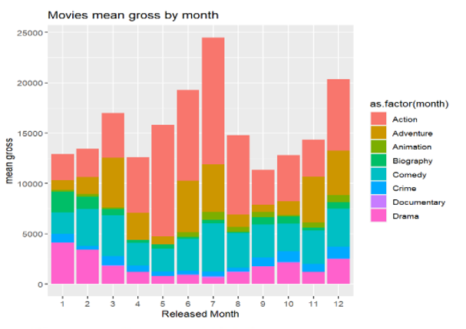
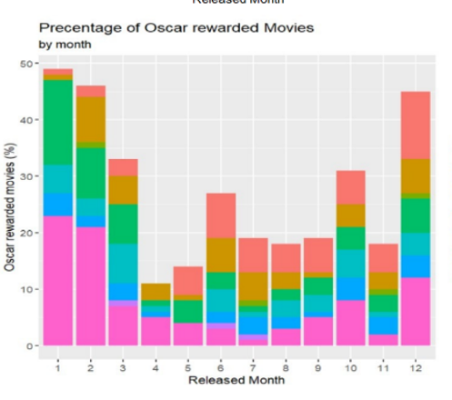

Results and Conclusion
Summer Blockbusters vs. Winter Oscar-Hopefuls

Slide 7
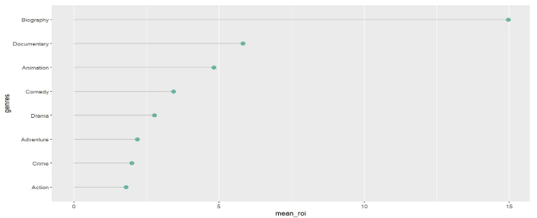
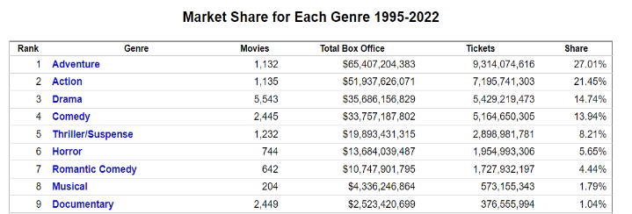
Results and Conclusion
movie's genre affects it's success factors?
Table from: https://www.the-numbers.com/market/genres

Slide 8
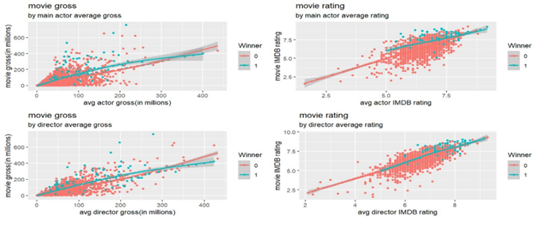
Results and Conclusion
How director and main actor rating affect the movie's success parameters?
When thinking about influential roles in production, the first that springs to mind is of course the director. The clue is in the name – they direct the film, meaning they have a lot of control over the outcome. In this project we calculated the average rating of every director and actor in our data until the last movie they made, by that, we could get a little sense about the quality of them in any given time and see how it affects the success features

Slide 9
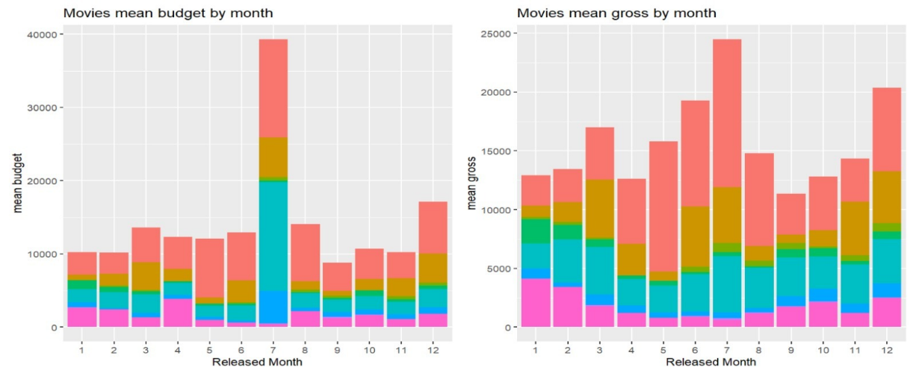
Charts
A
B

Slide 10
Charts

Slide 11

בהצלחה בתקופה מבחנים

